Slide 1
Different types of media network

Slide 2
Network Media Types
Communication transmits across a network on media. The media provides the channel over which the message travels from source to destination.Modern networks primarily use three types of media to interconnect devices, as shown in the figure:

Slide 3
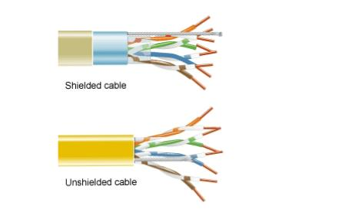
Twisted-Pair Cable
Ethernet technology generally uses twisted-pair cables to interconnect devices. Because Ethernet is the foundation for most local networks, twisted-pair is the most commonly encountered type of network cabling.In twisted-pair, wires are grouped in pairs and twisted together to reduce interference. The pairs of wires are colored so that you can identify the same wire at each end. Typically, in each pair, one of the wires is a solid color and its partner is the same color striped onto a white background.

Slide 4
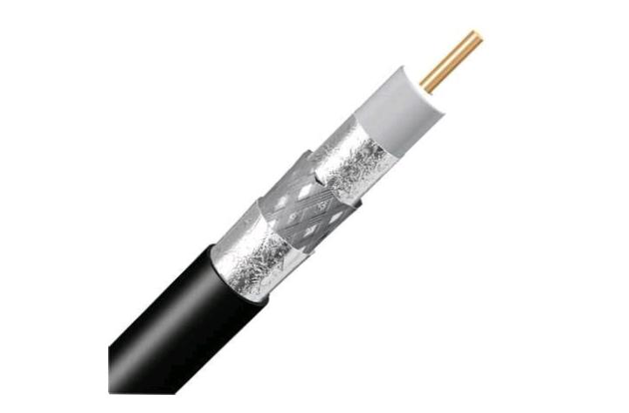
Coaxial Cable
Coaxial was one of the earliest types of network cabling developed. Coaxial cable is the kind of copper cable used by cable TV companies. It is also used for connecting the various components which make up satellite communication systems. Coaxial cable has a single rigid copper core that conducts the signal. This core is typically surrounded by a layer of insulation, braided metal shielding, and a protective jacket. It is used as a high-frequency transmission line to carry high-frequency or broadband signals.

Slide 5
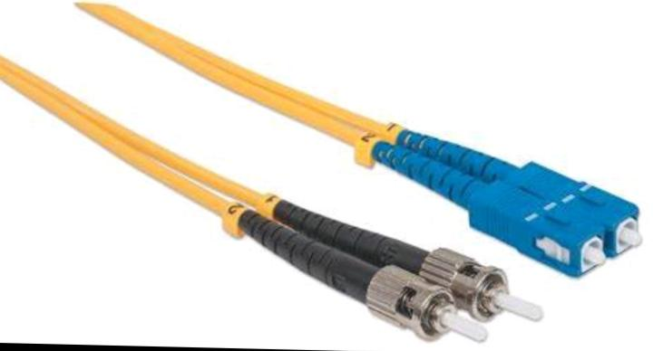
Fiber-Optic Cable
Fiber-optic cable can be either glass or plastic with a diameter about the same as a human hair and it can carry digital information at very high speeds over long distances. Because light is used instead of electricity, electrical interference does not affect the signal. Fiber-optic cables have many uses as well as communications. They are also used in medical They have a very high bandwidth, which enables them to carry very large amounts of data. Fiber is used in backbone networks, large enterprise environments, and large data centers. It is also used extensively by telephone companies., medical treatment, and mechanical engineering inspection.

